Slide 1
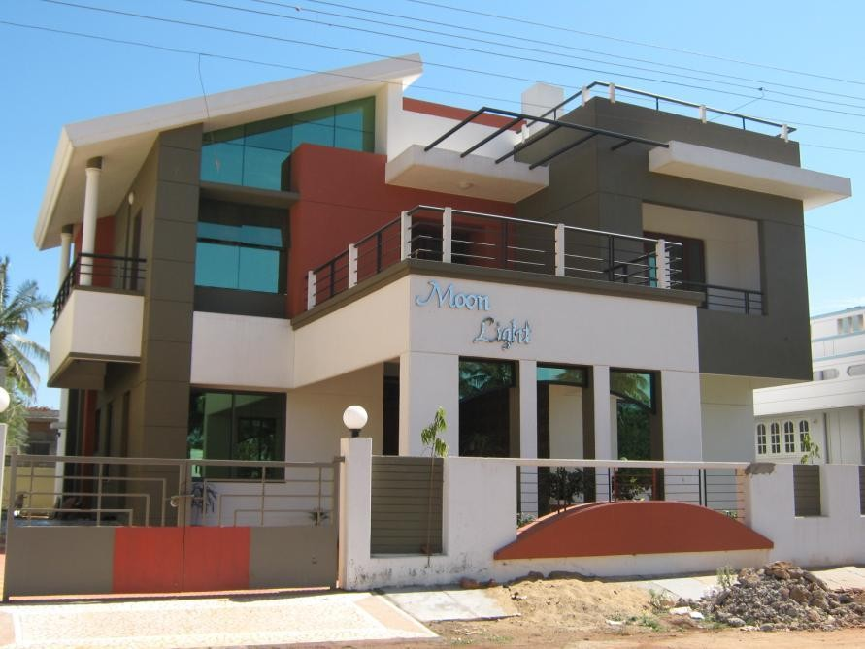
BUILDING COMPONENTS AND THEIR FUNCTIONS

Slide 2
Buildings
a building can be defined as an enclosed structure intended for human occupancy.
a building includes the structure itself and nonstructural components permanently attached to and supported by the structure.

Slide 3
Building functions--
To build means making use of solid materials to create a space that will fulfil a particular function.
Satisfy the need for which it was built (function).
Must resist the loads coming to it i.e. (must be stable).
Must continue to fulfill its function (durability).
Must be achieved with the minimum use of resources. (economy).

Slide 4
Components of residential building and their functions
Two- substructure and superstructure
Substructure-
portion below ground level
transmits the load of superstructure to the soil
foundation
Superstructure-
Constructed above substructure

Slide 5
The components of a building can be broadly summarized as follows:
Foundations
Walls
Floors
Doors and windows
Stairs
Roof
Services etc.

Slide 6
I. FOUNDATIONS.
lowest part of a structure-
below the ground level
which is in direct contact with the ground
transmits all dead, live and other loads to the soil beneath
in a manner -do not stress the soil beyond its safe allowable bearing capacity

Slide 7
Foundation…..
function of the foundation - to spread the load from a building to the ground
so that any movement that will occur do not cause damage to any part of the building
should be strong
It should be stable
Stability dependent on
the way in which the foundation transmits the load to the soil,
&the way in which the soil reacts.
Strength- influenced by the kind of materials used for its construction.

Slide 8
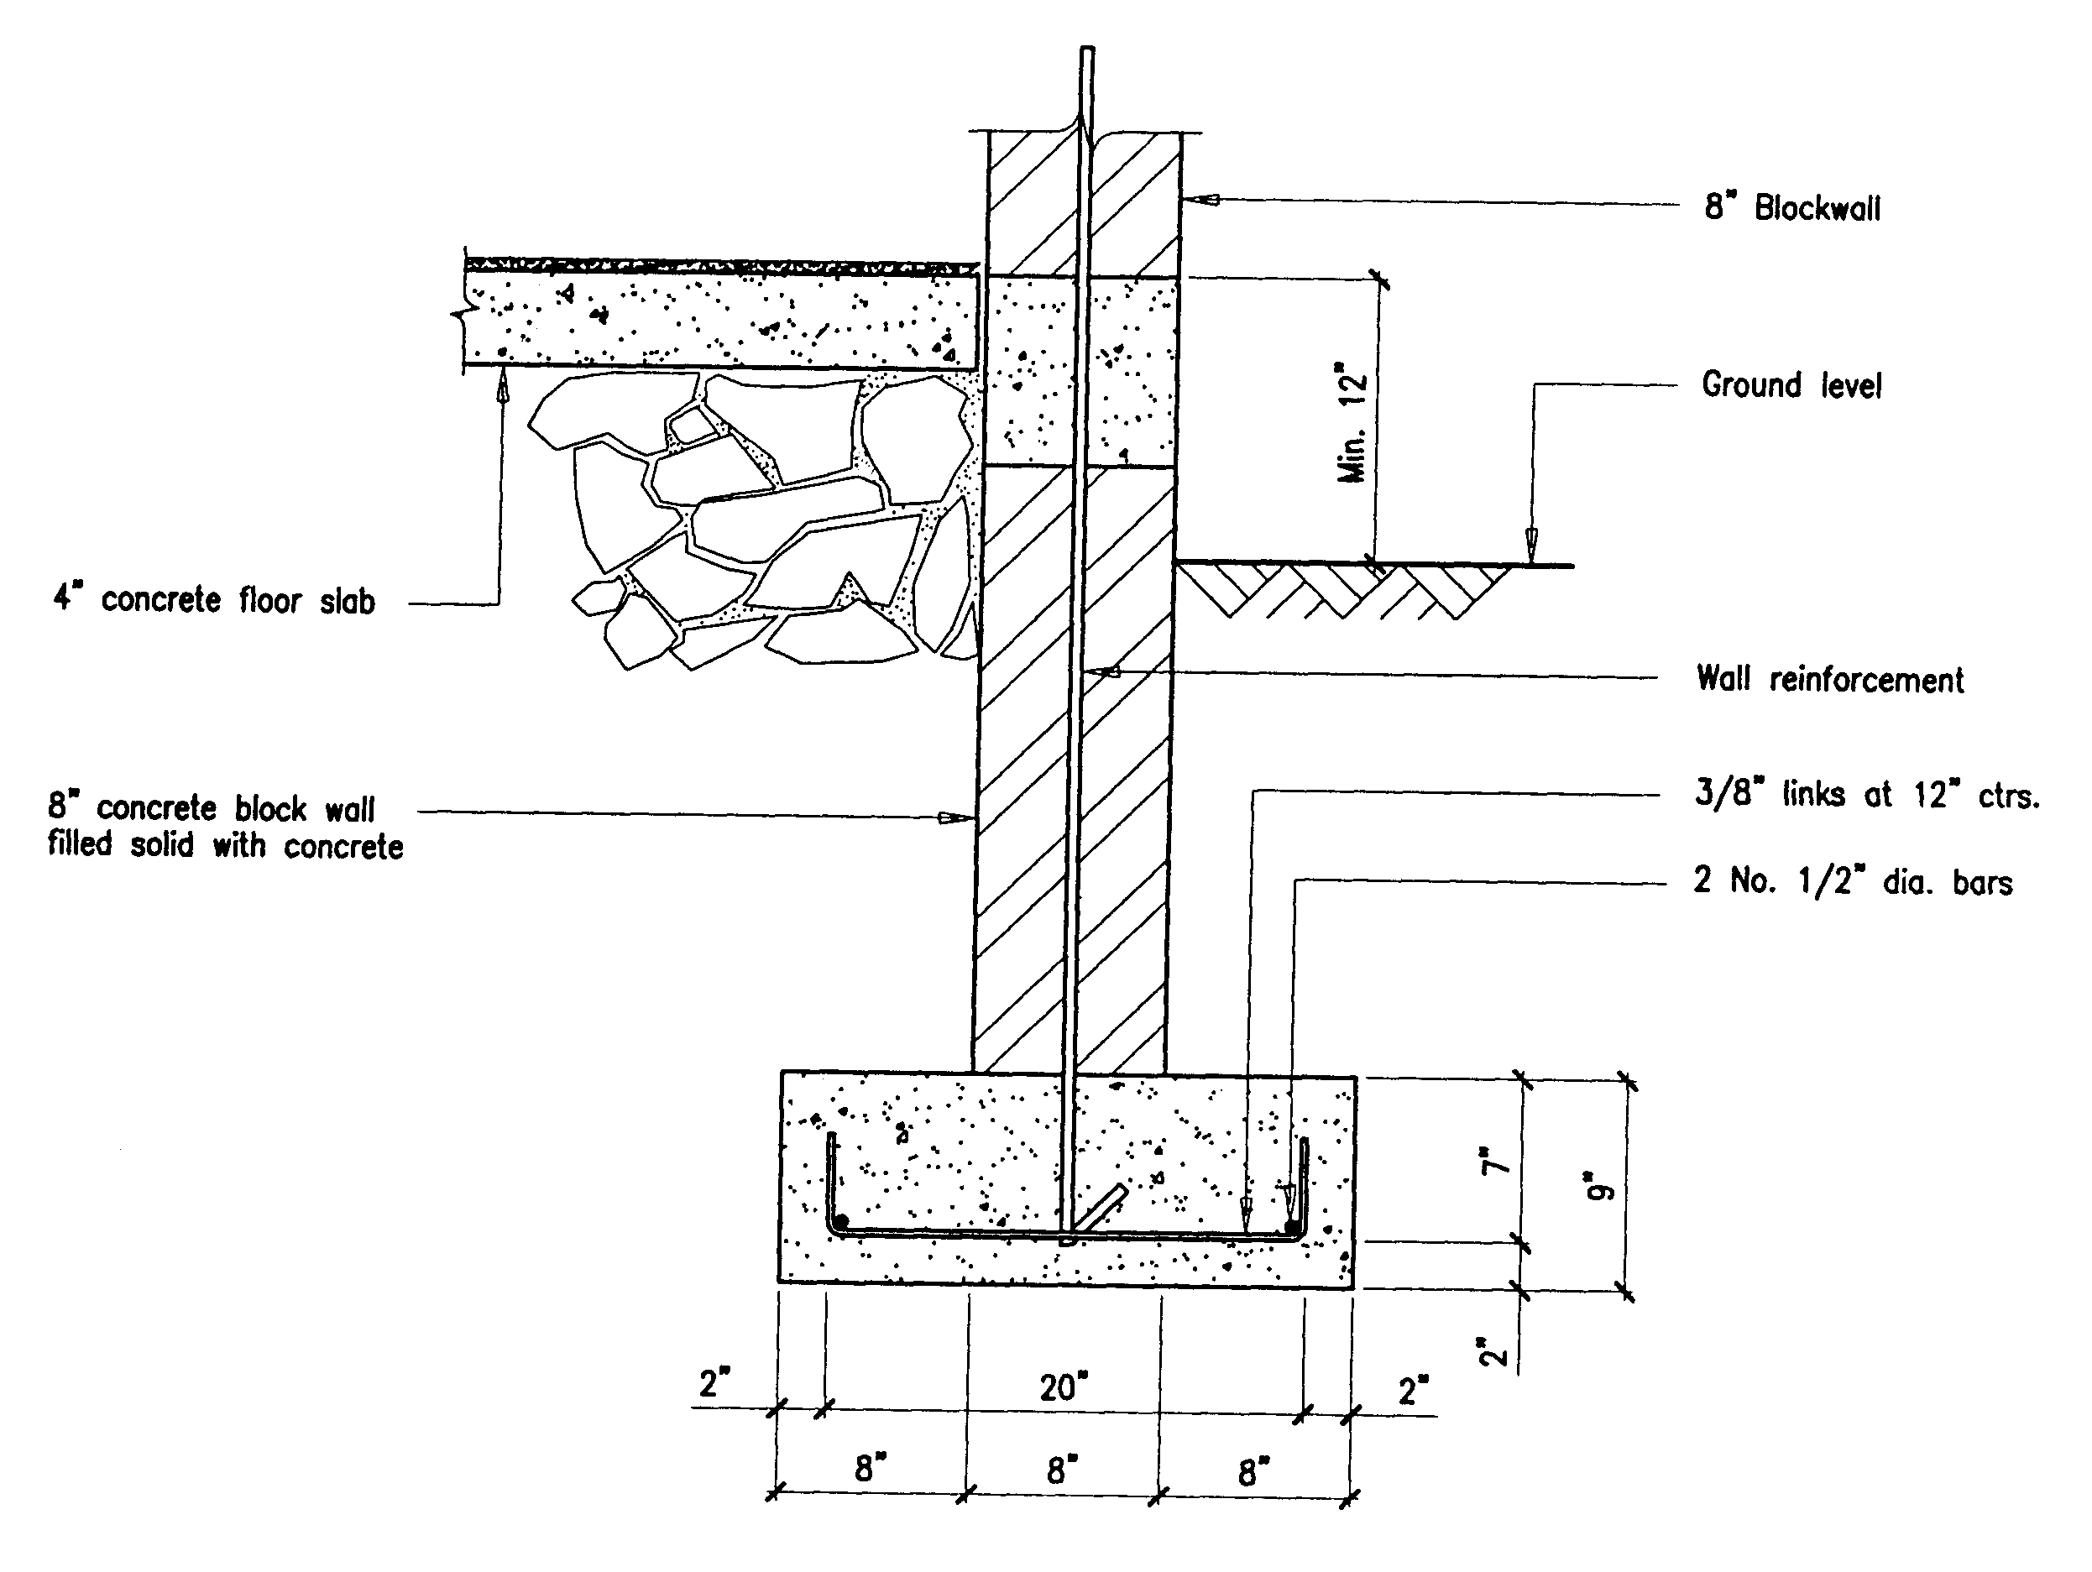

Slide 9
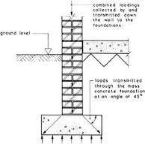

Slide 10
II. WALLS
constructed with various types of material -ranging from blocks, bricks, concrete, stones.
The external walls separate the outside from the inside, and enclose the space within.
The internal walls –divide room spaces -partition walls.

Slide 11
FUNCTIONS OF WALL….
1. It should support upper floors and roofs
2. Walls should resist damp penetration
3.Walls should provide adequate thermal insulation
4. walls should provide sufficient sound insulation
5. Walls should offer adequate fire resistance

Slide 12
III. FLOORS
Floors are the horizontal elements which divide the building into different levels for the purpose of creating more accommodation within a restricted space one above the other
provide support for the occupants, furniture and equipment of a building. The floor of a building immediately above the ground is known as ground floor.
All other floors which are above the ground floor are known as the upper floors.

Slide 13
The floors of the first storey is known as the first floor
that of the second storey is known as the second floor etc, etc.
In case, part of the building is constructed below the ground level, or the building has the basement, the floor is known as basement floor.

Slide 14
Floor….
Every floor has a structural component:
(i) the sub-floor, which is a structural component to impart strength and stability to support the super-imposed loads and
(ii) floor covering or flooring consisting of suitable floor finish.
Floor covering provides a smooth, clean, impervious and durable surface.
Floor area is usable covered area of a building at any floor level.
Floor area ratio (F.A.R) is defined as the quotient obtained by dividing the total covered area (plinth area) on all floors and 100 by the area of the plot.
FAR= (Total area covered by all floors x 100)/plot area

Slide 15
Floors….
A floor – satisfy the following:
Strength &stability- to support the floor covering & super imposed loads
Durability & damp prevention-clean, smooth, impervious , durable and wear resistance
Heat insulation- imp in gr. & basement floor
- When suspended and
ventilated timber floor
4. Sound insulation and fire proof- imp in upper floors-they act as hzl barriers for passage of sound and fire in vertical dir.

Slide 16
Criteria for calculating floor areas and height of structures
Type of building
Cubic content per capita, m3
Residential buildings
Dormitories
Educational buildings
Institutional buildings
Industrial buildings
9
12-15
4.5-7.5
30
7.5

Slide 17
Criteria for calculating floor areas and height of structures
Type of building
Floor area per capita, m2
Residential buildings
Dormitories
Educational buildings
Institutional buildings
Industrial buildings
2.5-9
3-4
1-2
8-10
2-2.5

Slide 18
V. Doors & windows
Main function- doors-to serve as a connecting link between internal parts and to allow free movement to the outside of the building.
windows- for proper ventilation and lighting
Should satisfy the following :
Weather resistance- resist adverse effect of weather
Sound and thermal insulation- air tight
Damp prevention – not affected by moisture penetration- which reduce strength and durability
Termite prevention- not affect –by white ants

Slide 19
Doors and windows……
5. fire resistance and durability
6. Privacy and security- privacy without inconvenience or trouble and security against theft.

Slide 20
vi. Sills, lintels and weather shades
Sill- portion between the bottom of window frame and the wall below.
Function- to protect the wall from wear and tear
Lintel-
door frame and window frame- not so strong to support the masonry above it.
-separate str. Element is needed –between top of frame and wall above the opening
Weather shades- sunshades

Slide 21
Vii- ROOFS
UPPERMOST PART OF A BUILDING
Main fn.- to enclose the space and to protect the same from weathering effects.
imp as fdn.
Protection for the bldg itself
Prevents destruction from top.
satisfy the following requirements:
Strength and stability- strong enough to take the anticipated load safely.
Weather resistance-
Heat insulation-

Slide 22
Roofs…..
4. sound insulation from external sources
5. Fire resistance- to give protection against the spread of fire from any adjacent buildings and to prevent early collapse of roof-so that occupants should get sufficient time to escape.
-Spread of fire from its source to other parts by way of roof cannot occur.
6. Day lighting- provides daylight in buildings with large floor area.

Slide 23
Viii-STEPS & STAIRS
STEP- - riser and treads- supported by strings
STAIR- consists of no. of steps leading from one floor to other.
location – such as to afford easiest and quickest service possible to the bldg.
Main fn. Of stairs-
1.provide means of communication b/n the various floors.
2. Provide means of escape from the upper floors in case of fire.

Slide 24
Steps and stairs – satisfy……
Strength and stability- design as floors
-strong enough to carry anticipated loads of people using and furnitures- carried up & down.
2. Fire resistance-material selection
- provide safe means of escape in fire
3.Sound insulation – from external sources
4.Weather resistance- if exposed to open air –resistance to rain, heat etc..
5. Comfort - proper design and proper location of steps- provide comfort and efficiency in vertical movement, natural light and ventilation, safety in emergency.
-rise height- 15-17cm, tread width- 25-30cm, length -75cm min.

Slide 25
ix. FINISHES FOR WALLS
Types of finishes- pointing, plastering, painting, distempering, decorative colour washing, cladding etc.
Main fn.-
Protect the structure –exposed surfaces from the effects of weather.
Provide a true, even and smooth finished surface and also improve the aesthetic appearance of the structure as a whole.
Cover up the unsound and porous material used in the construction.

